Slide 1
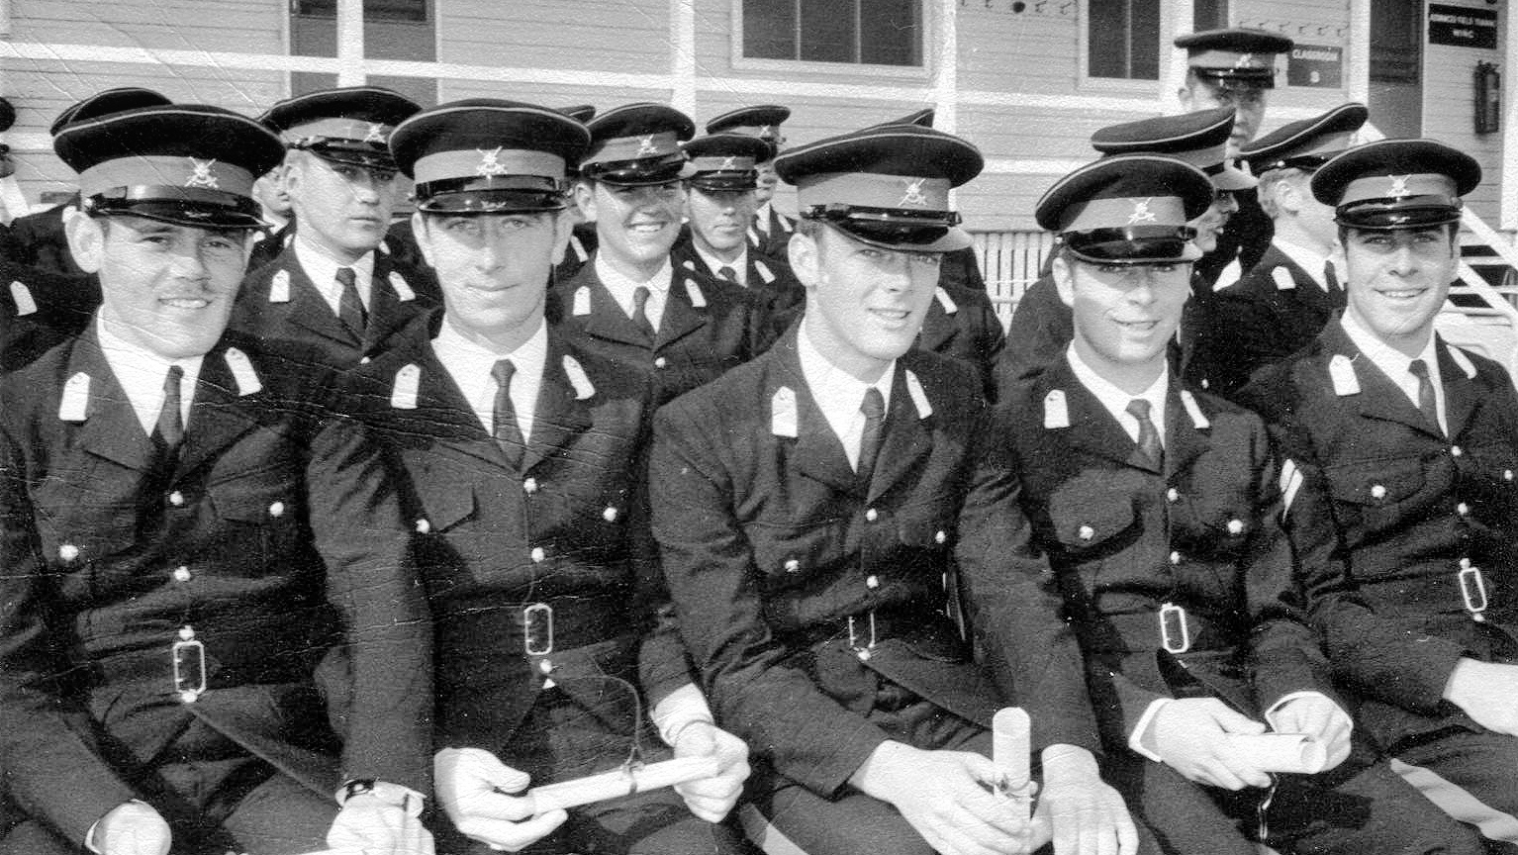
Officer Training Unit Scheyville
Graduation Church Parade Class 1/71
11 July 1971
The Freeman Collection

Slide 2
OFFICER TRAINING UNIT SCHEYVILLE GRADUATION CHURCH PARADE CLASS 1/71 - 11 JULY 1971
Marched In 144
1 Repeated from Class 4/70
Graduated 104 (103 & 1 Repeat)
7 Repeated & Graduated with Class 2/71

Slide 3
March On - Band, followed by Senior (Graduating ) Class & Junior Class and Markers

Slide 4
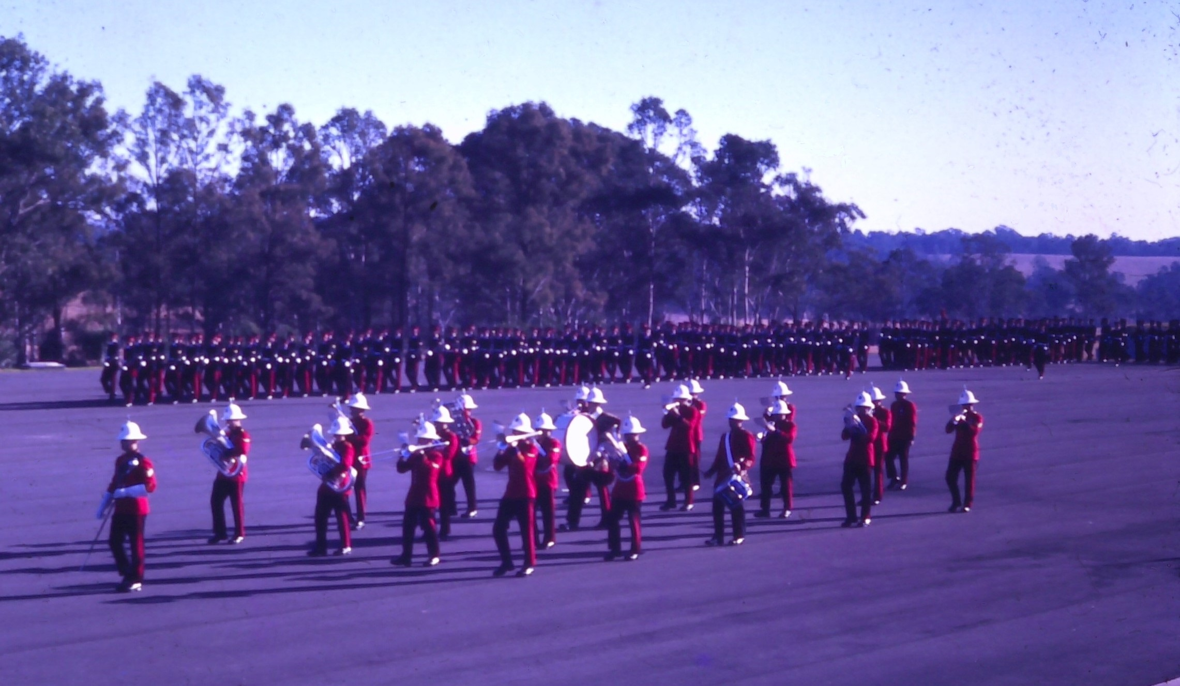

Slide 5
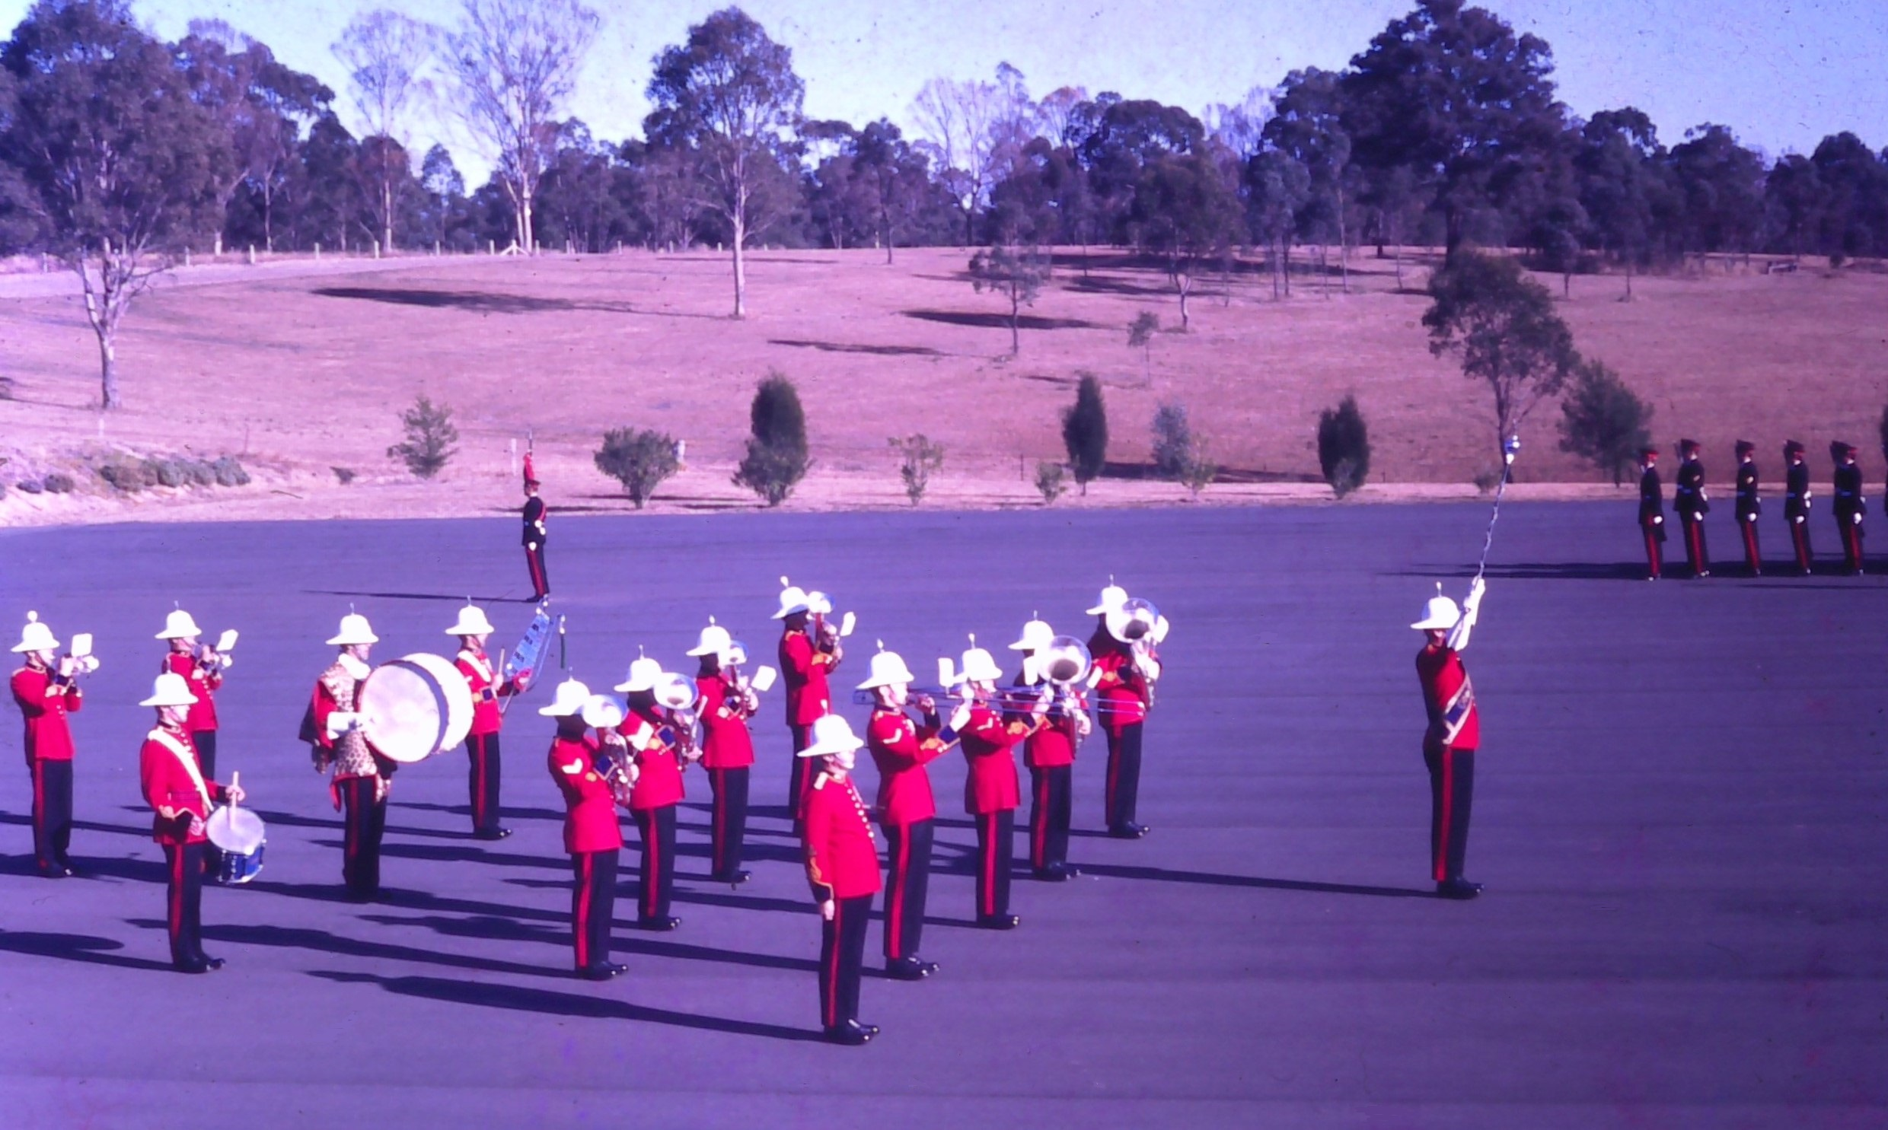

Slide 6
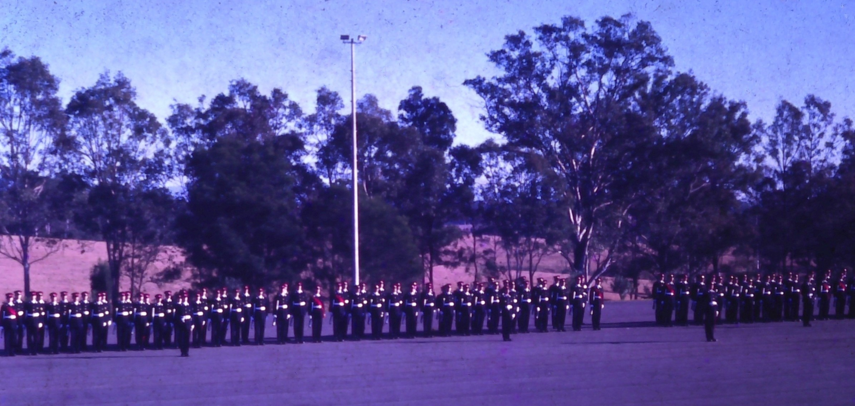
Parade Awaits Governor-General’s Banner Party

Slide 7
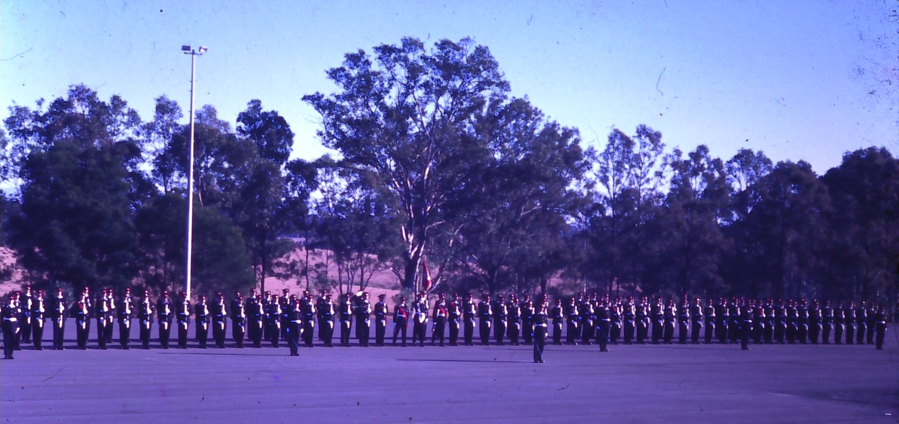
Governor-General’s Banner Party turns into Position

Slide 8
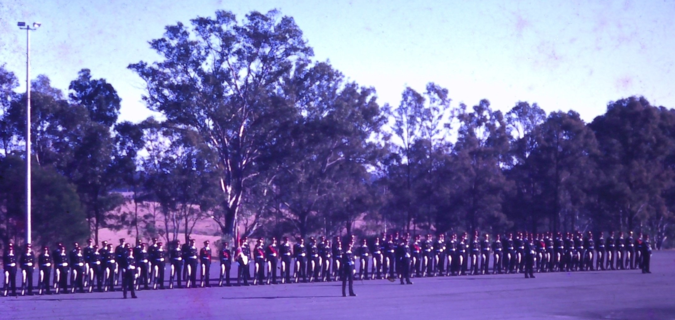
Governor-General’s Banner Party in Position

Slide 9
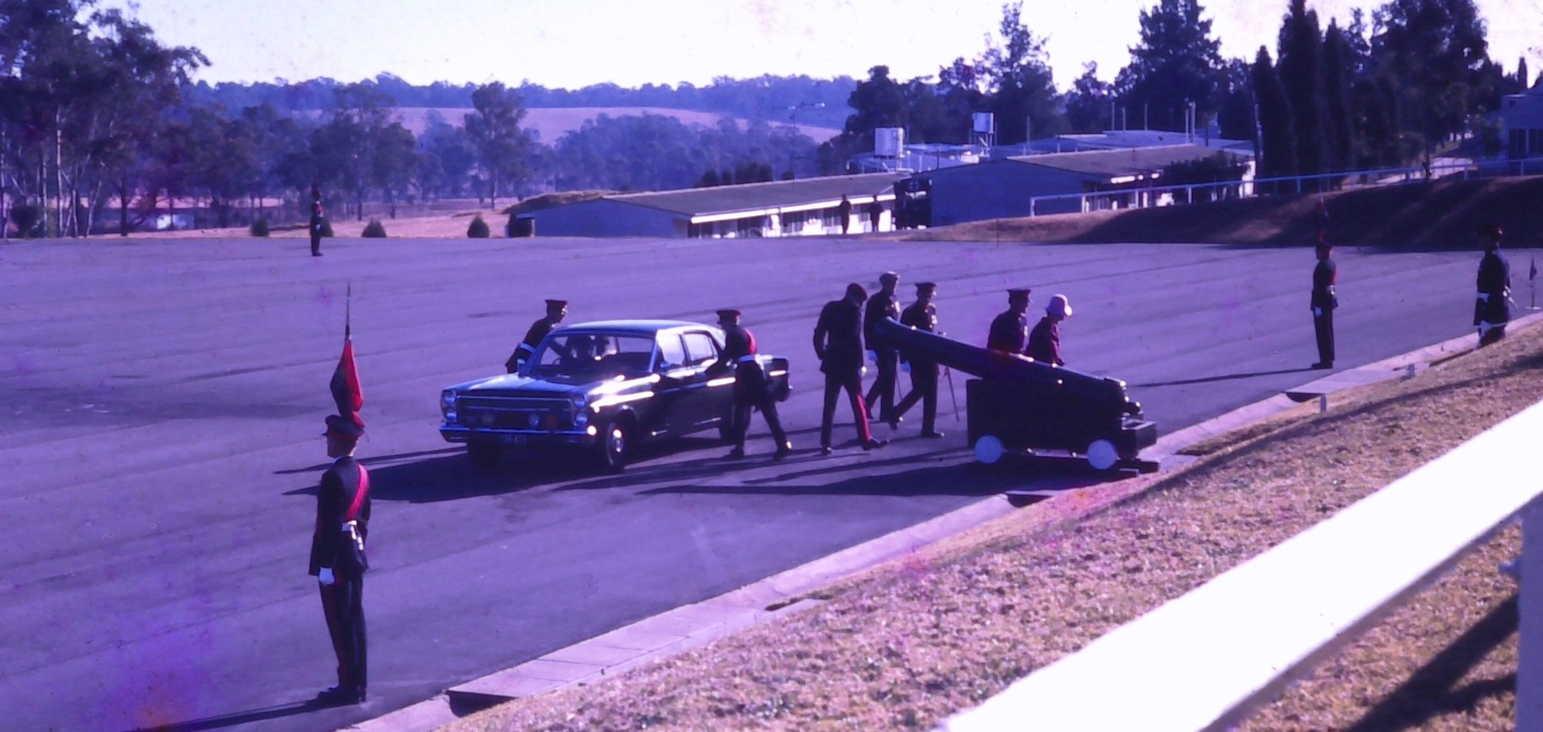
VIPs Arrive & Receive a General Salute

Slide 10
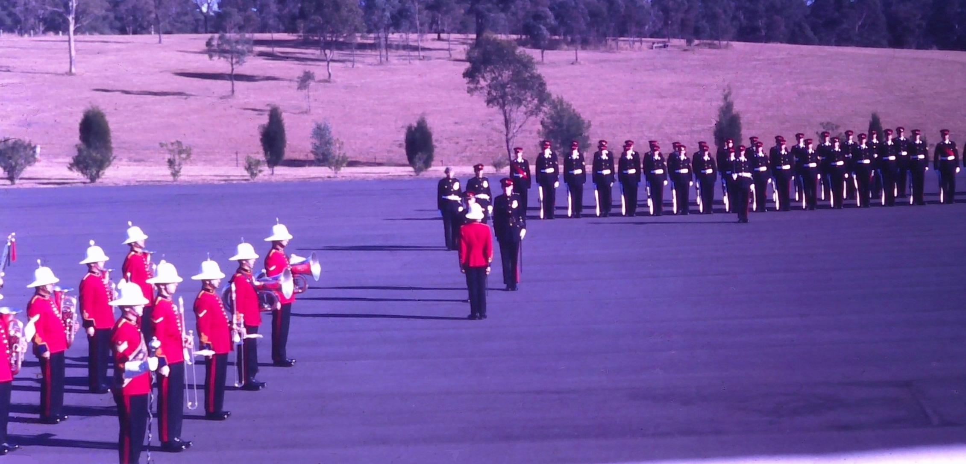
Following Inspection of Parade VIP Inspects the Band

Slide 11
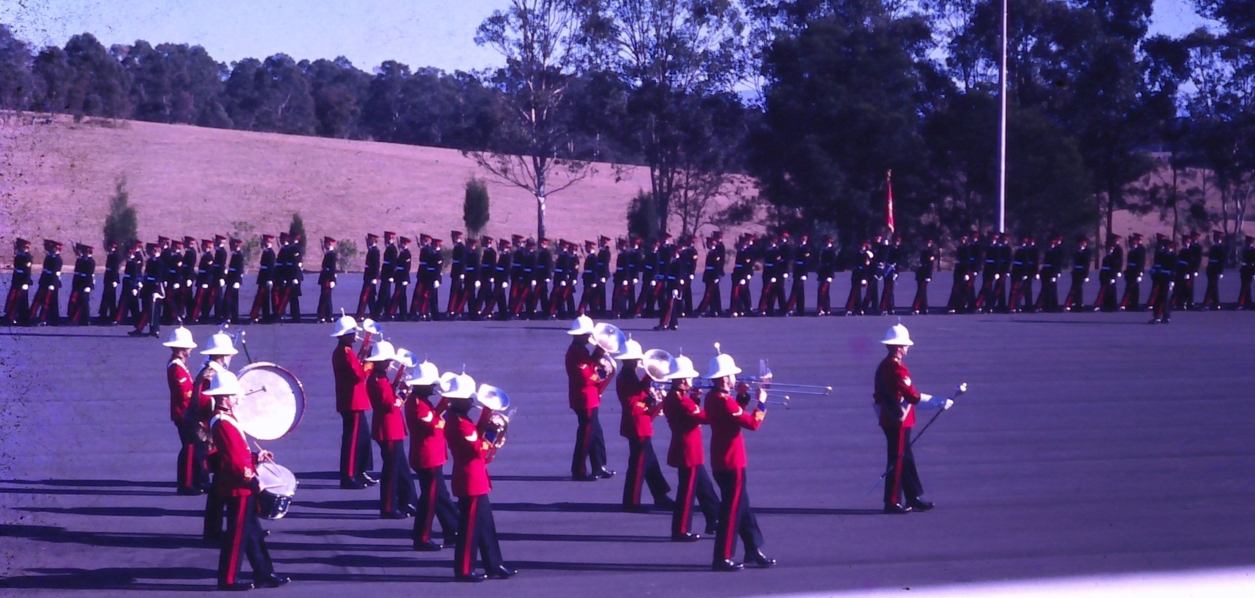
Parade Marches Past in Slow Time – Senior Class Leading

Slide 12
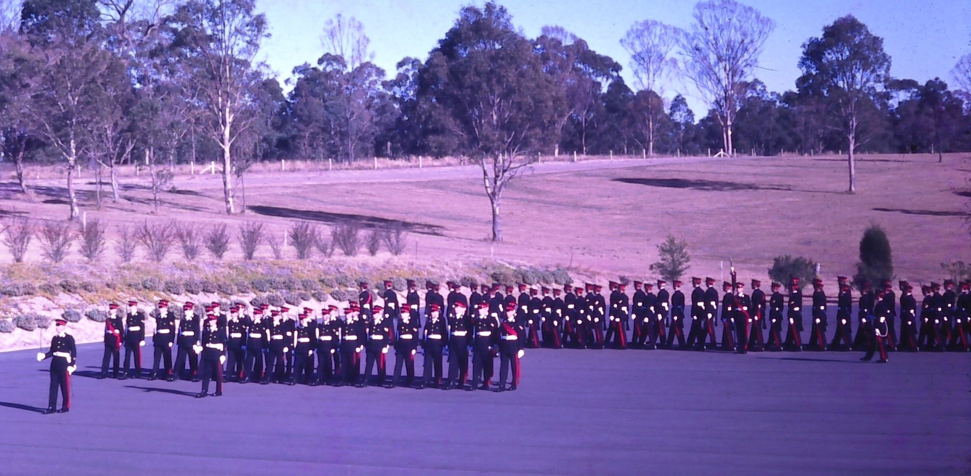
Battalion Sergeant Major SUO D’Arcy Leads Parade

Slide 13
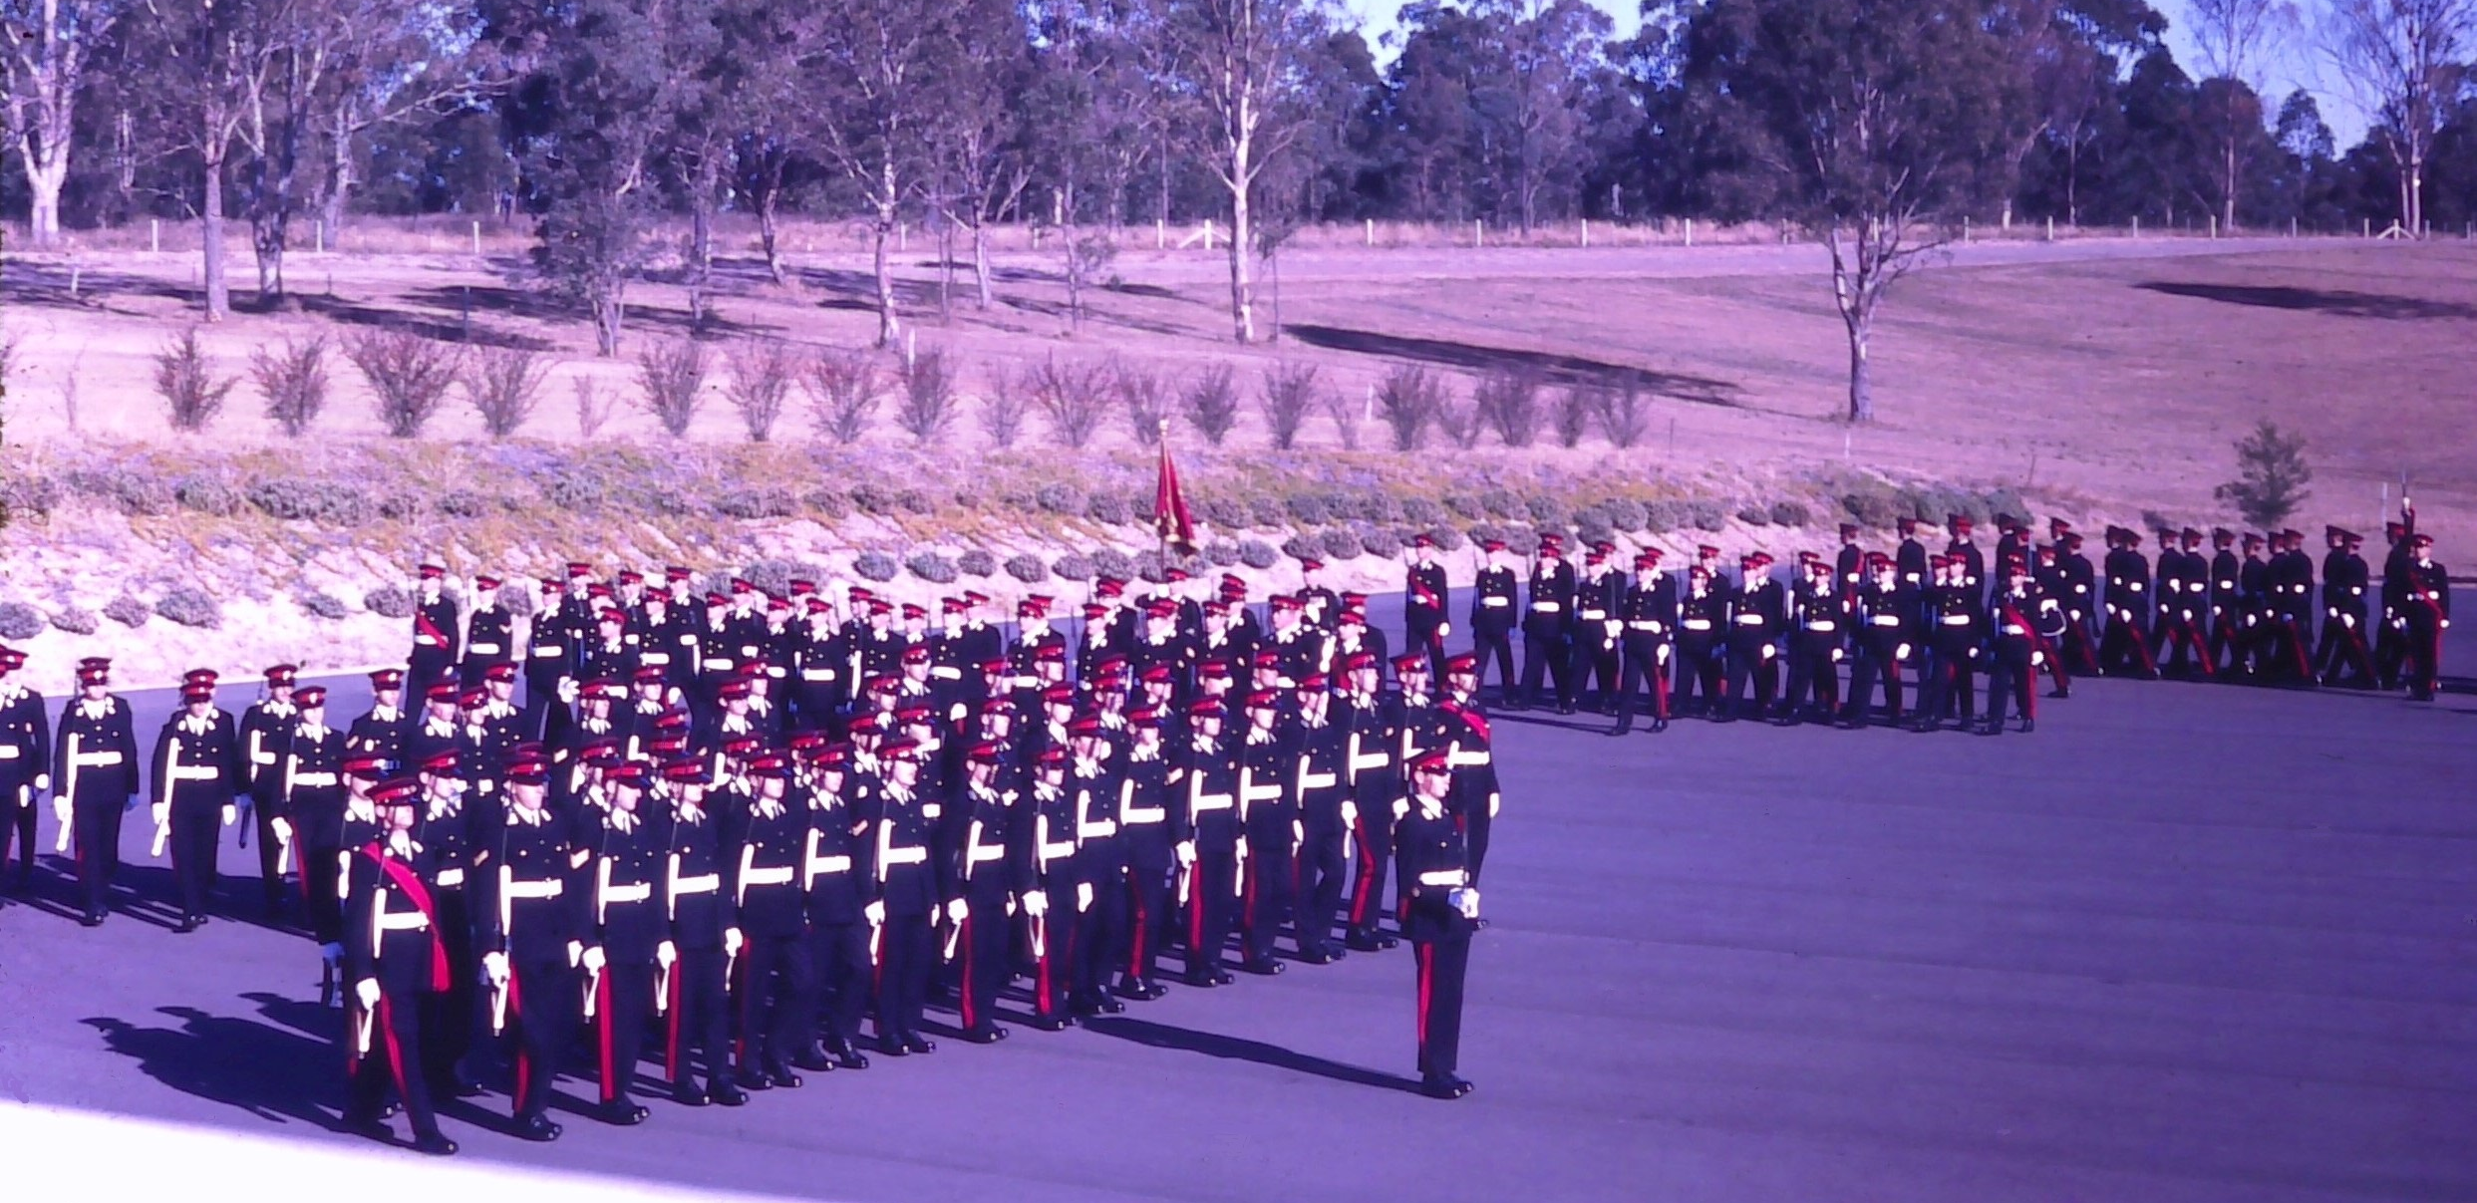
Number 1 Guard led by UO Rutter of Blamey Coy

Slide 14
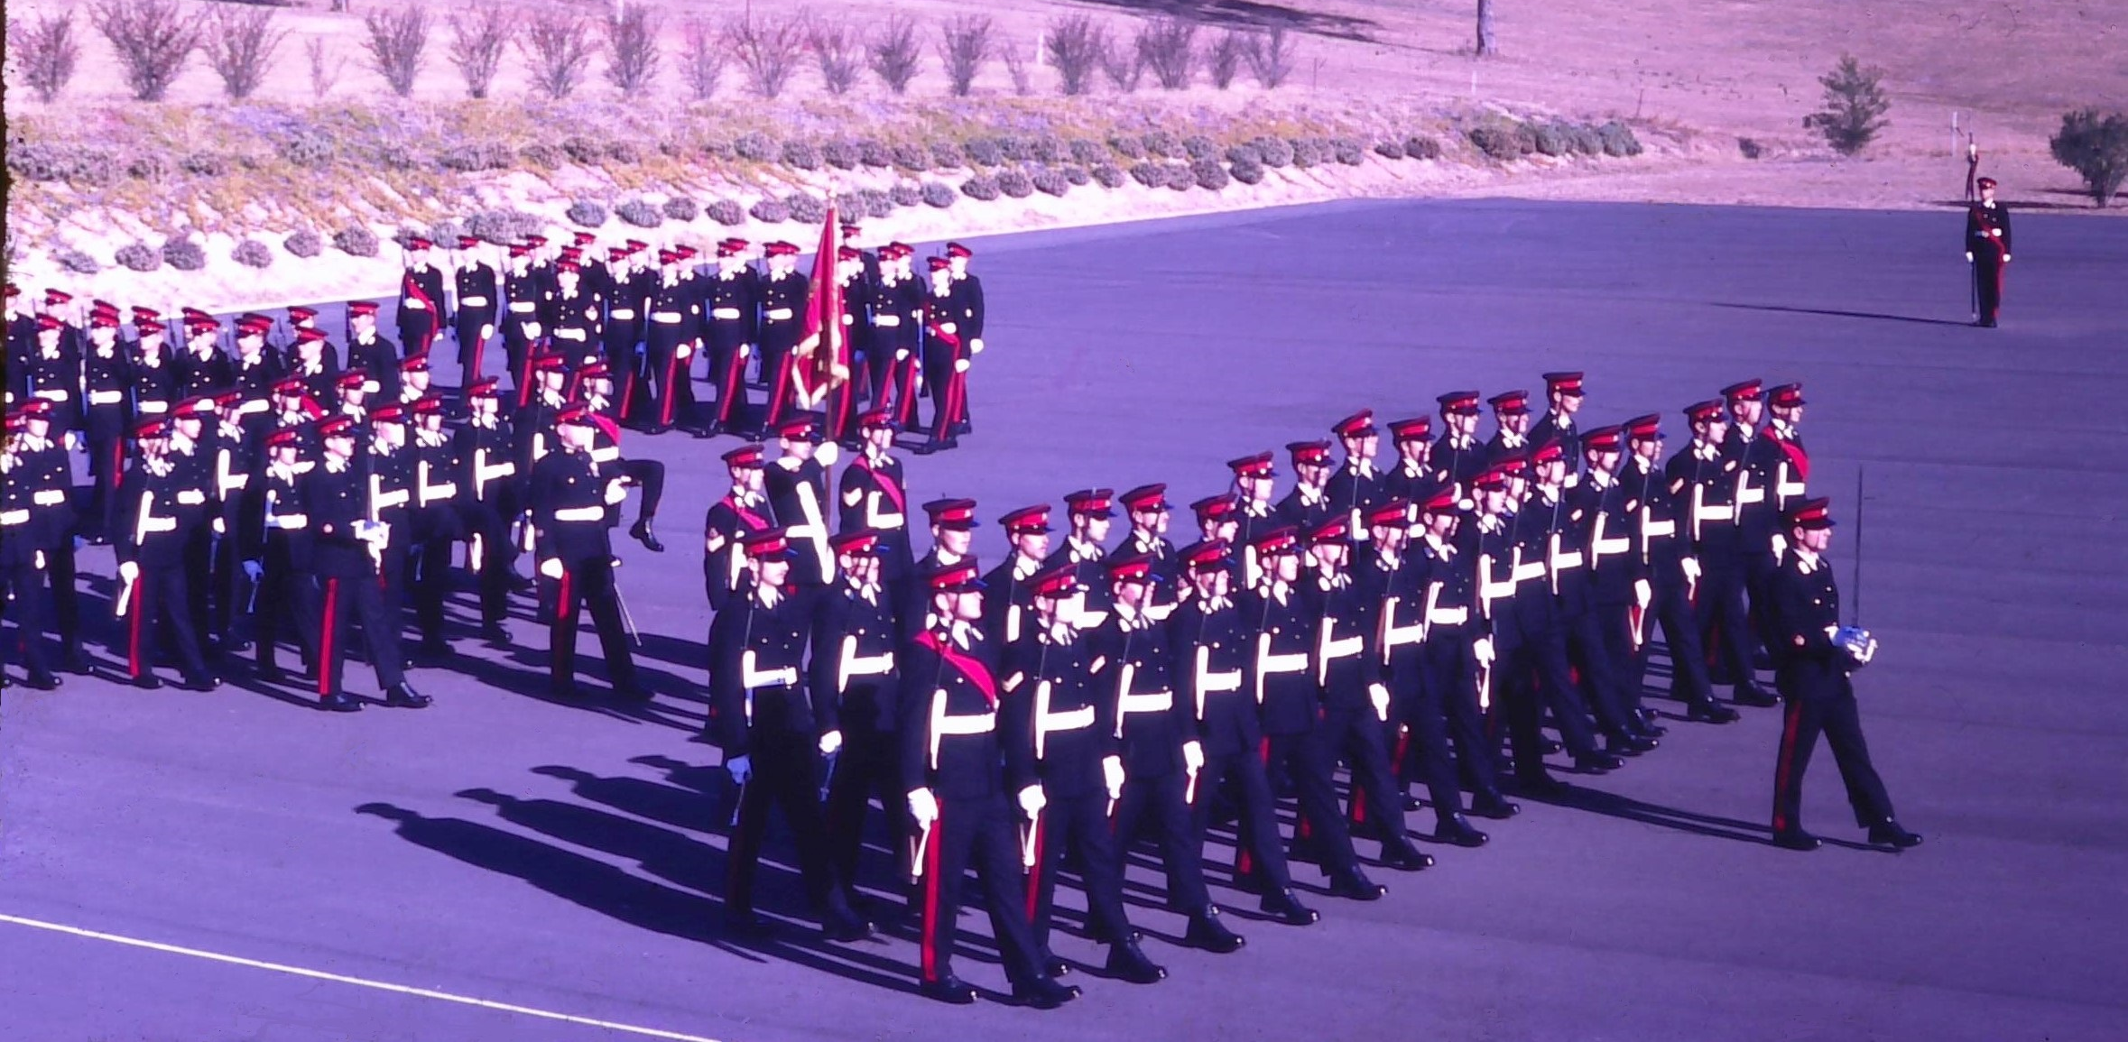
Number 3 Guard led by UO Chessell of Chauvel Coy

Slide 15
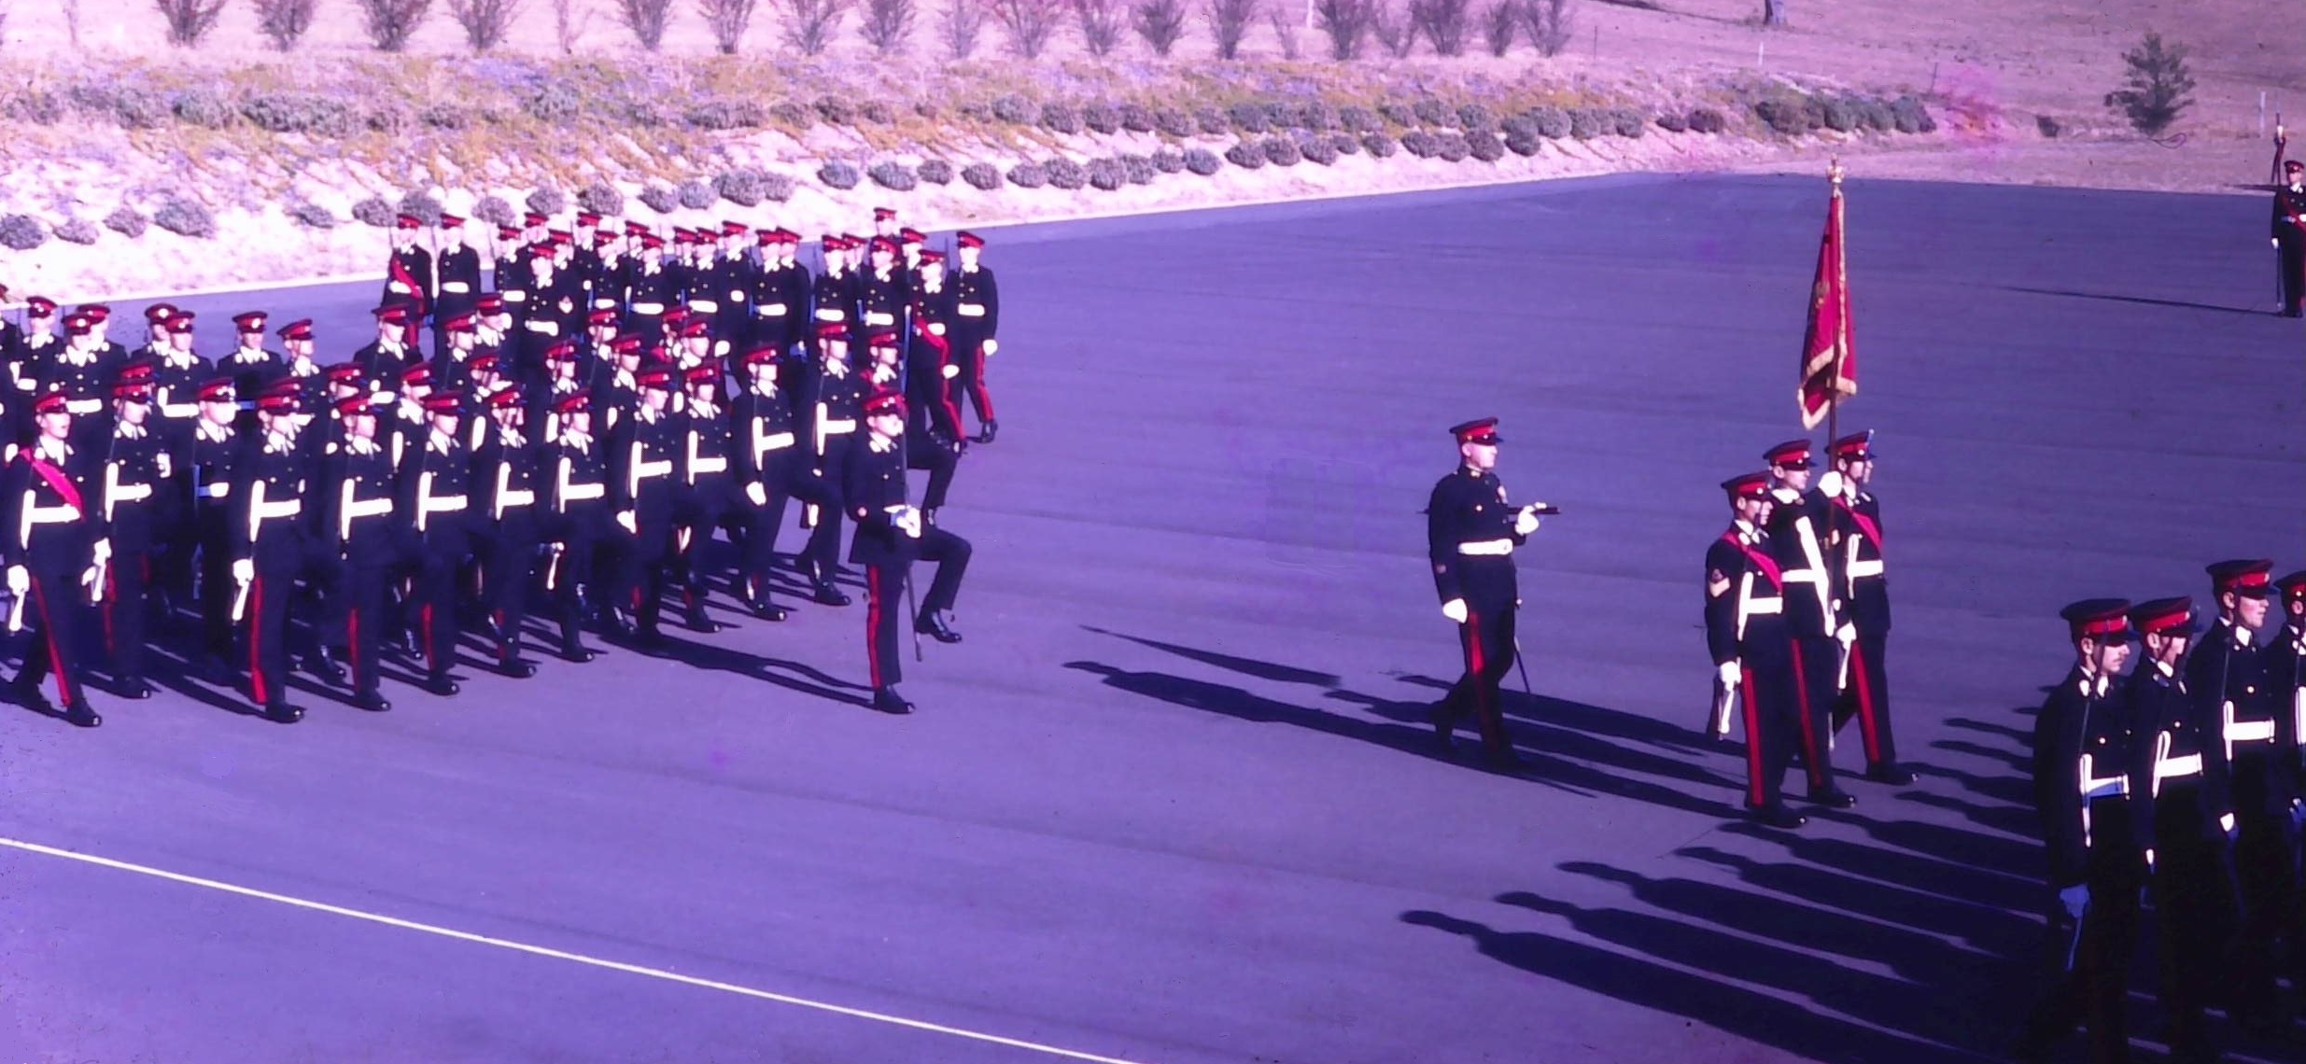
GG Banner Party UO Mychajlyk & No 4 Guard Led by UO McCallum

Slide 16
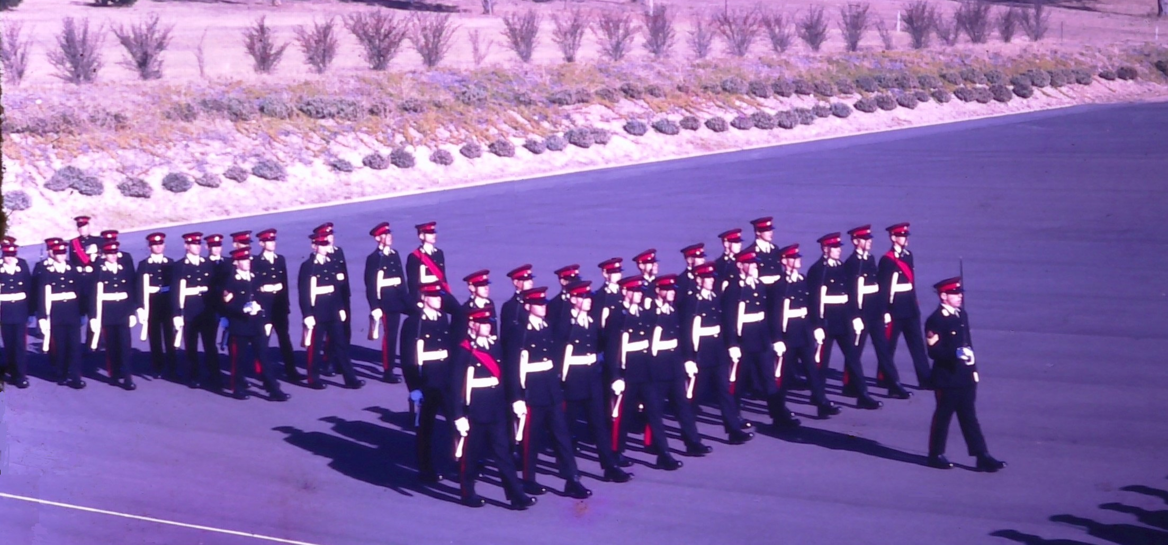
Number 5 & 6 Guards led by Col Sgts Kuhl (Bridges Coy) & Col Sgt Kesby (Monash Coy)

Slide 17
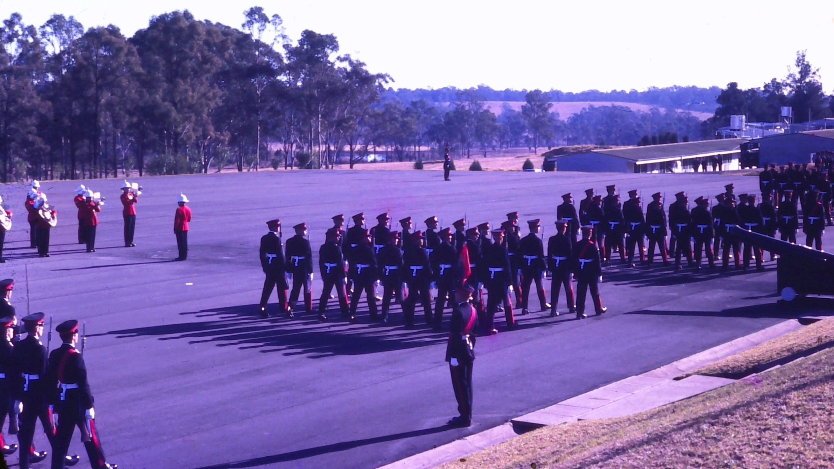

Slide 18
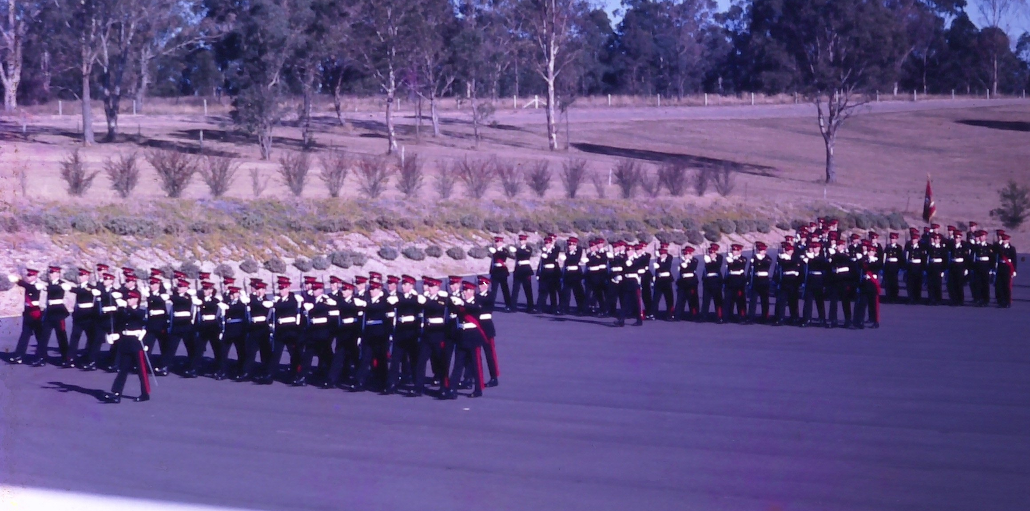
Quick March

Slide 19
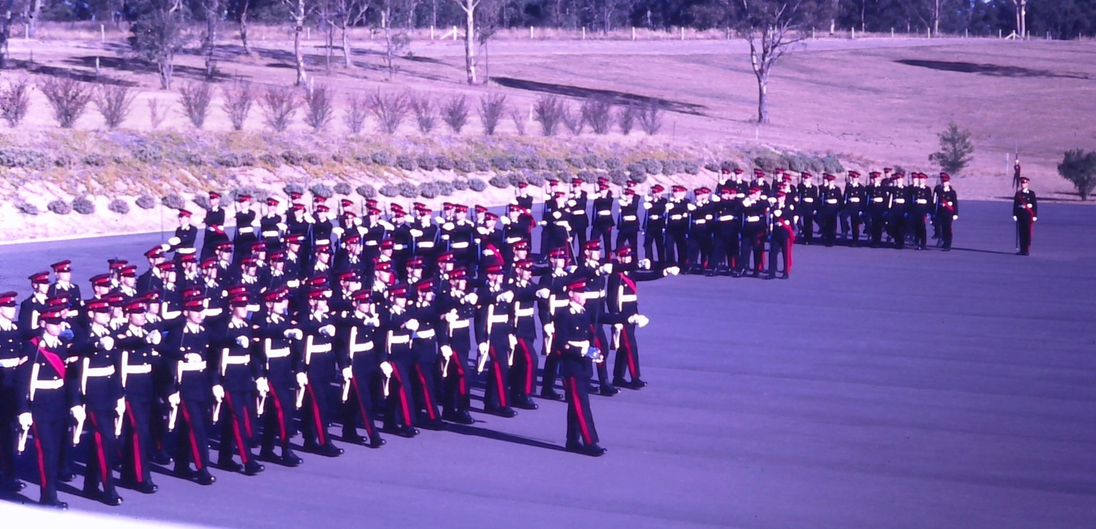
No 2 Guard Led By UO Tucker of Bridges Company

Slide 20
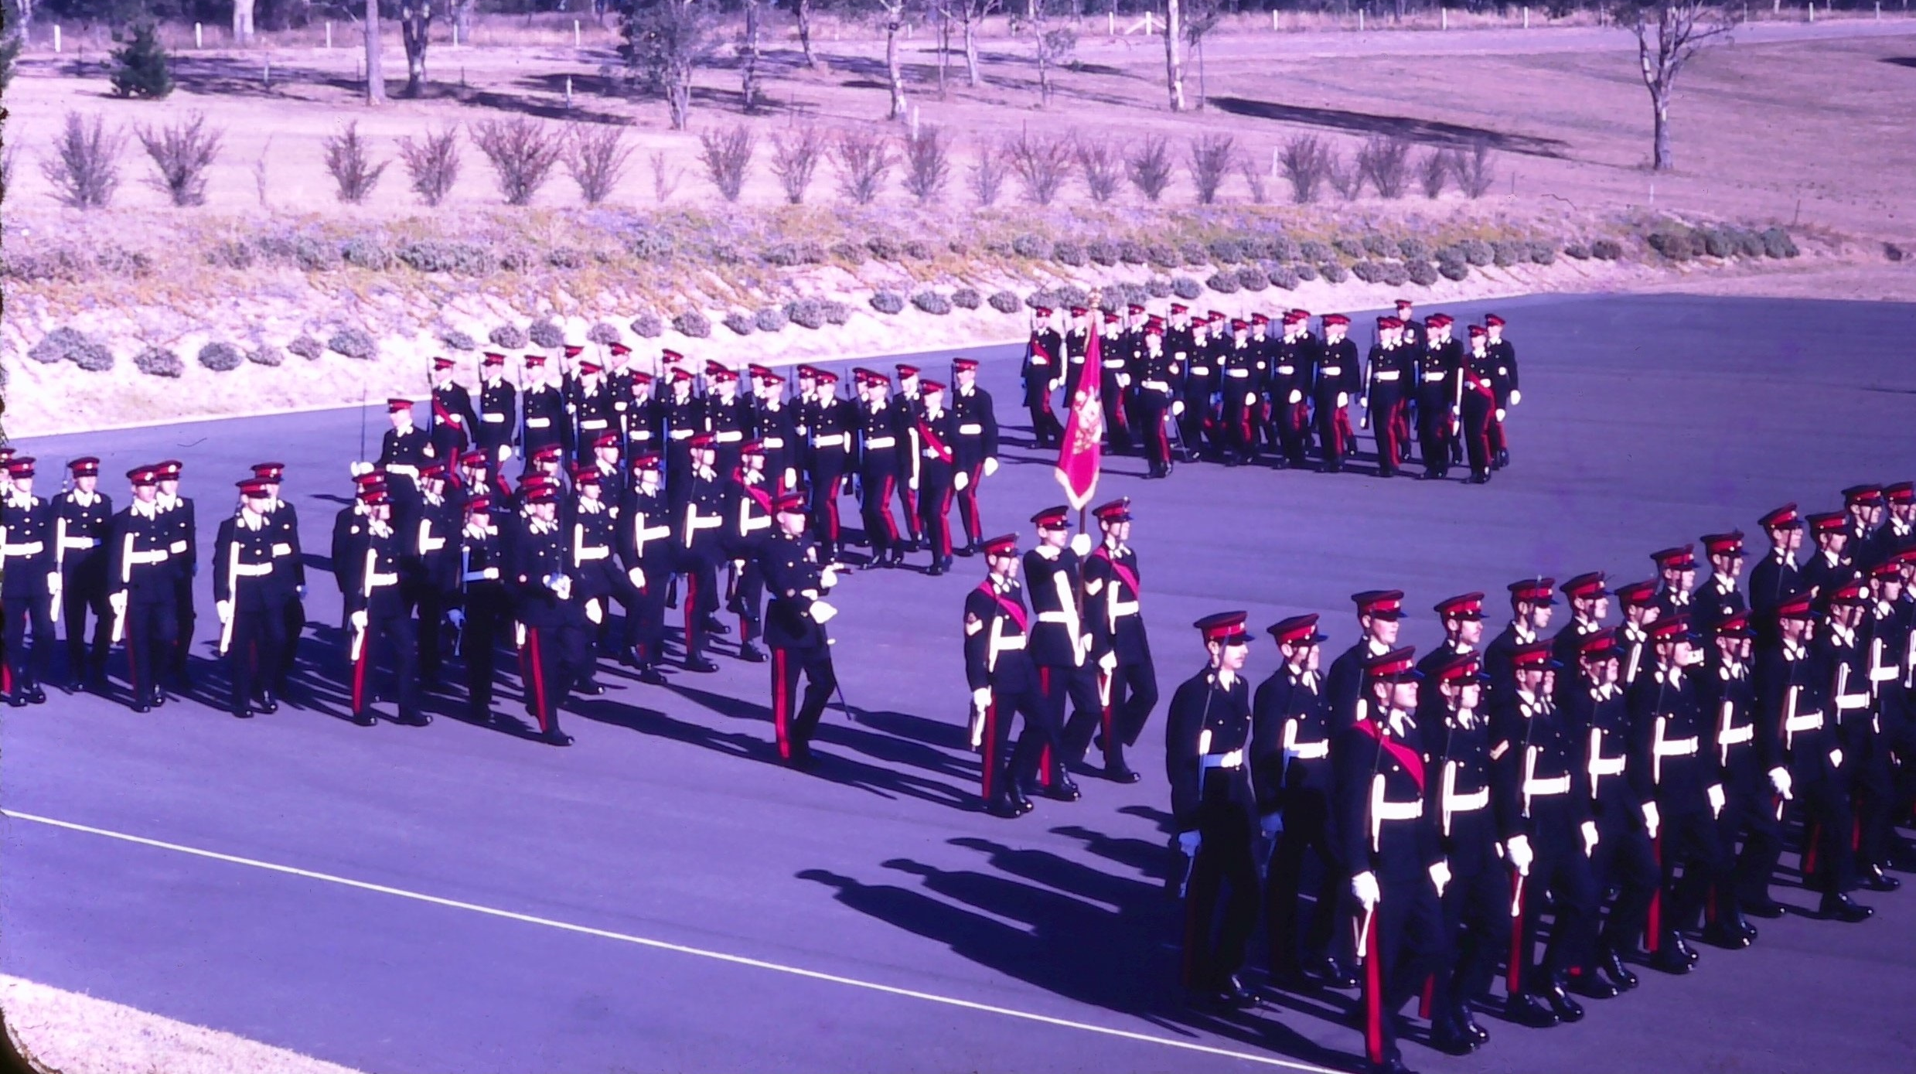

Slide 21
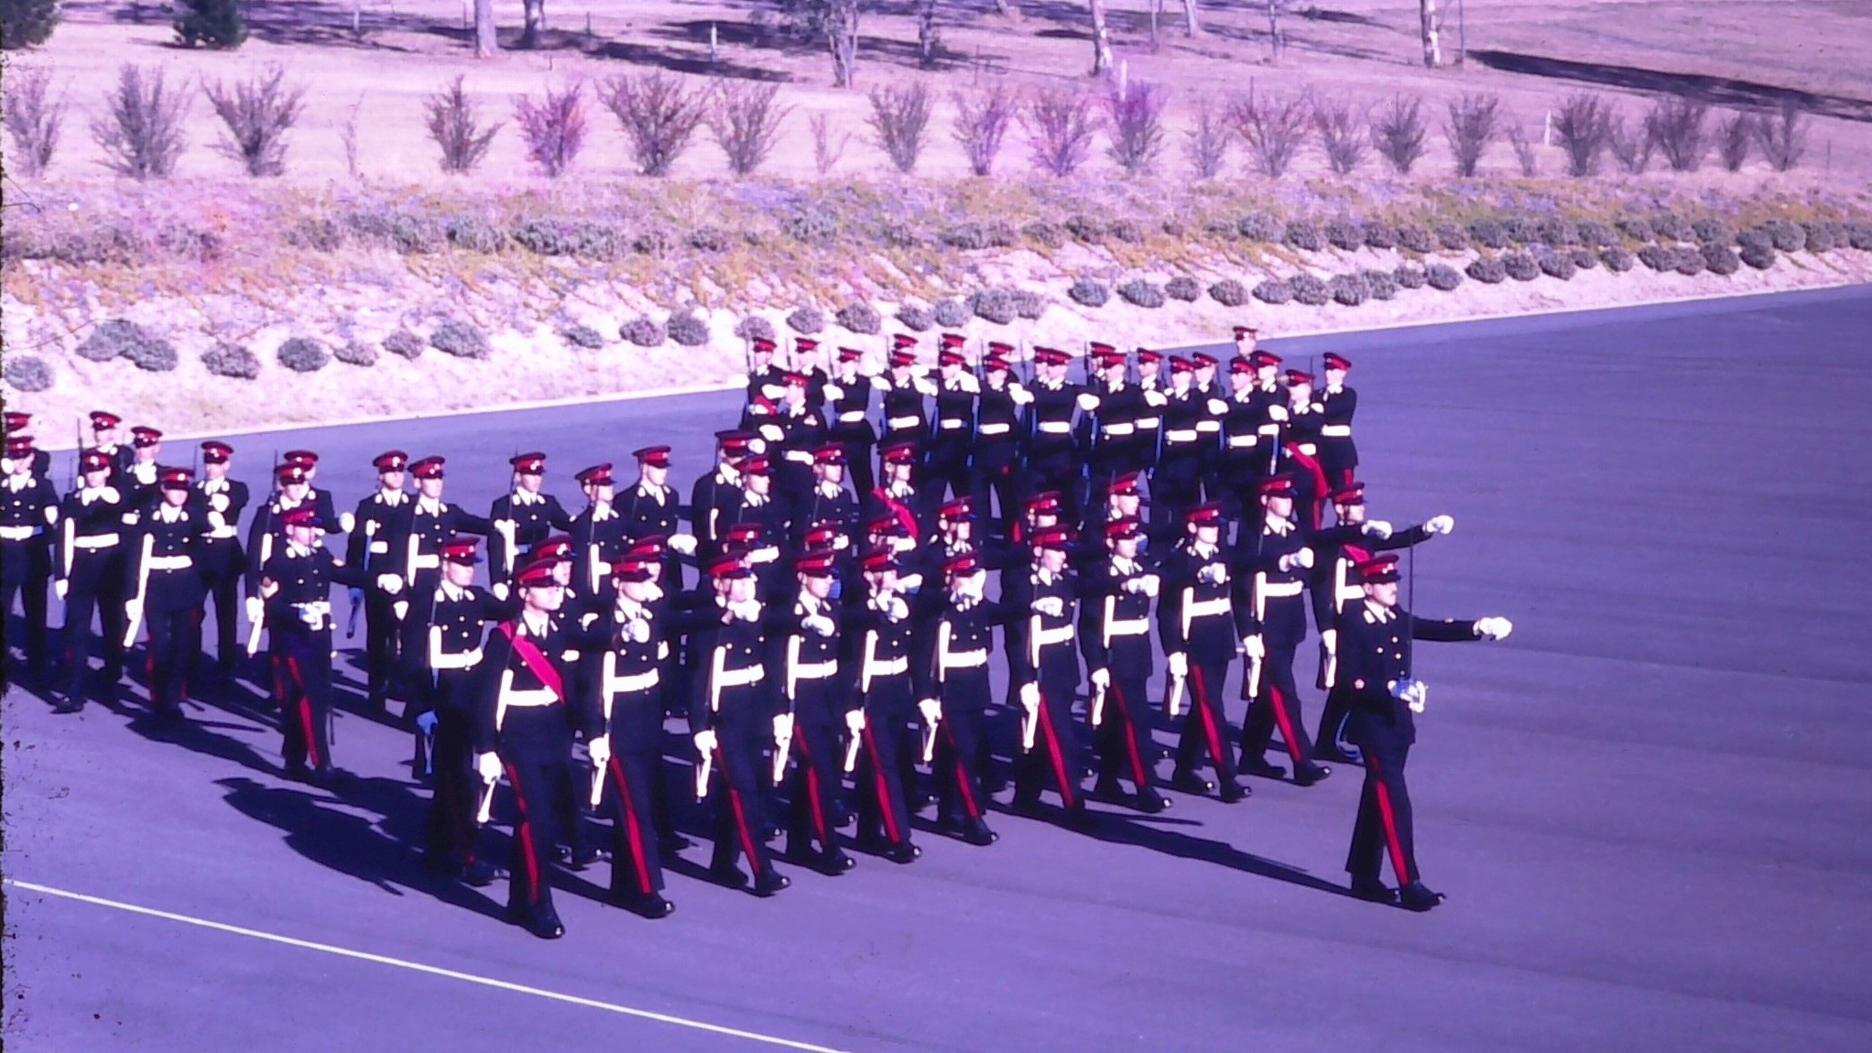

Slide 22
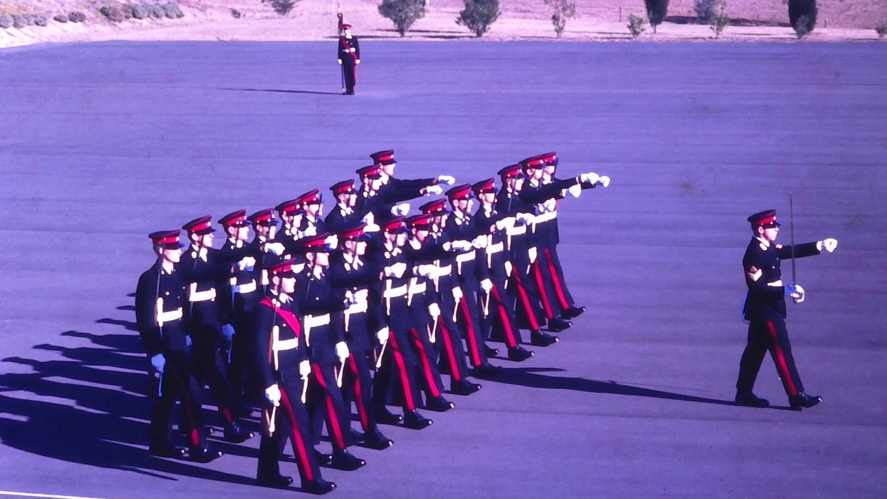

Slide 23
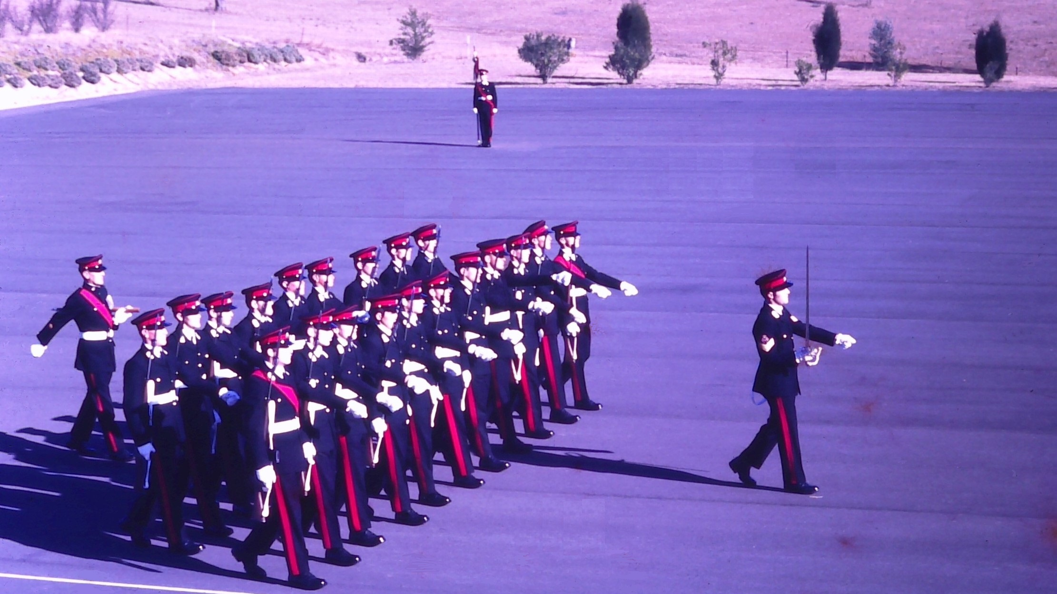

Slide 24
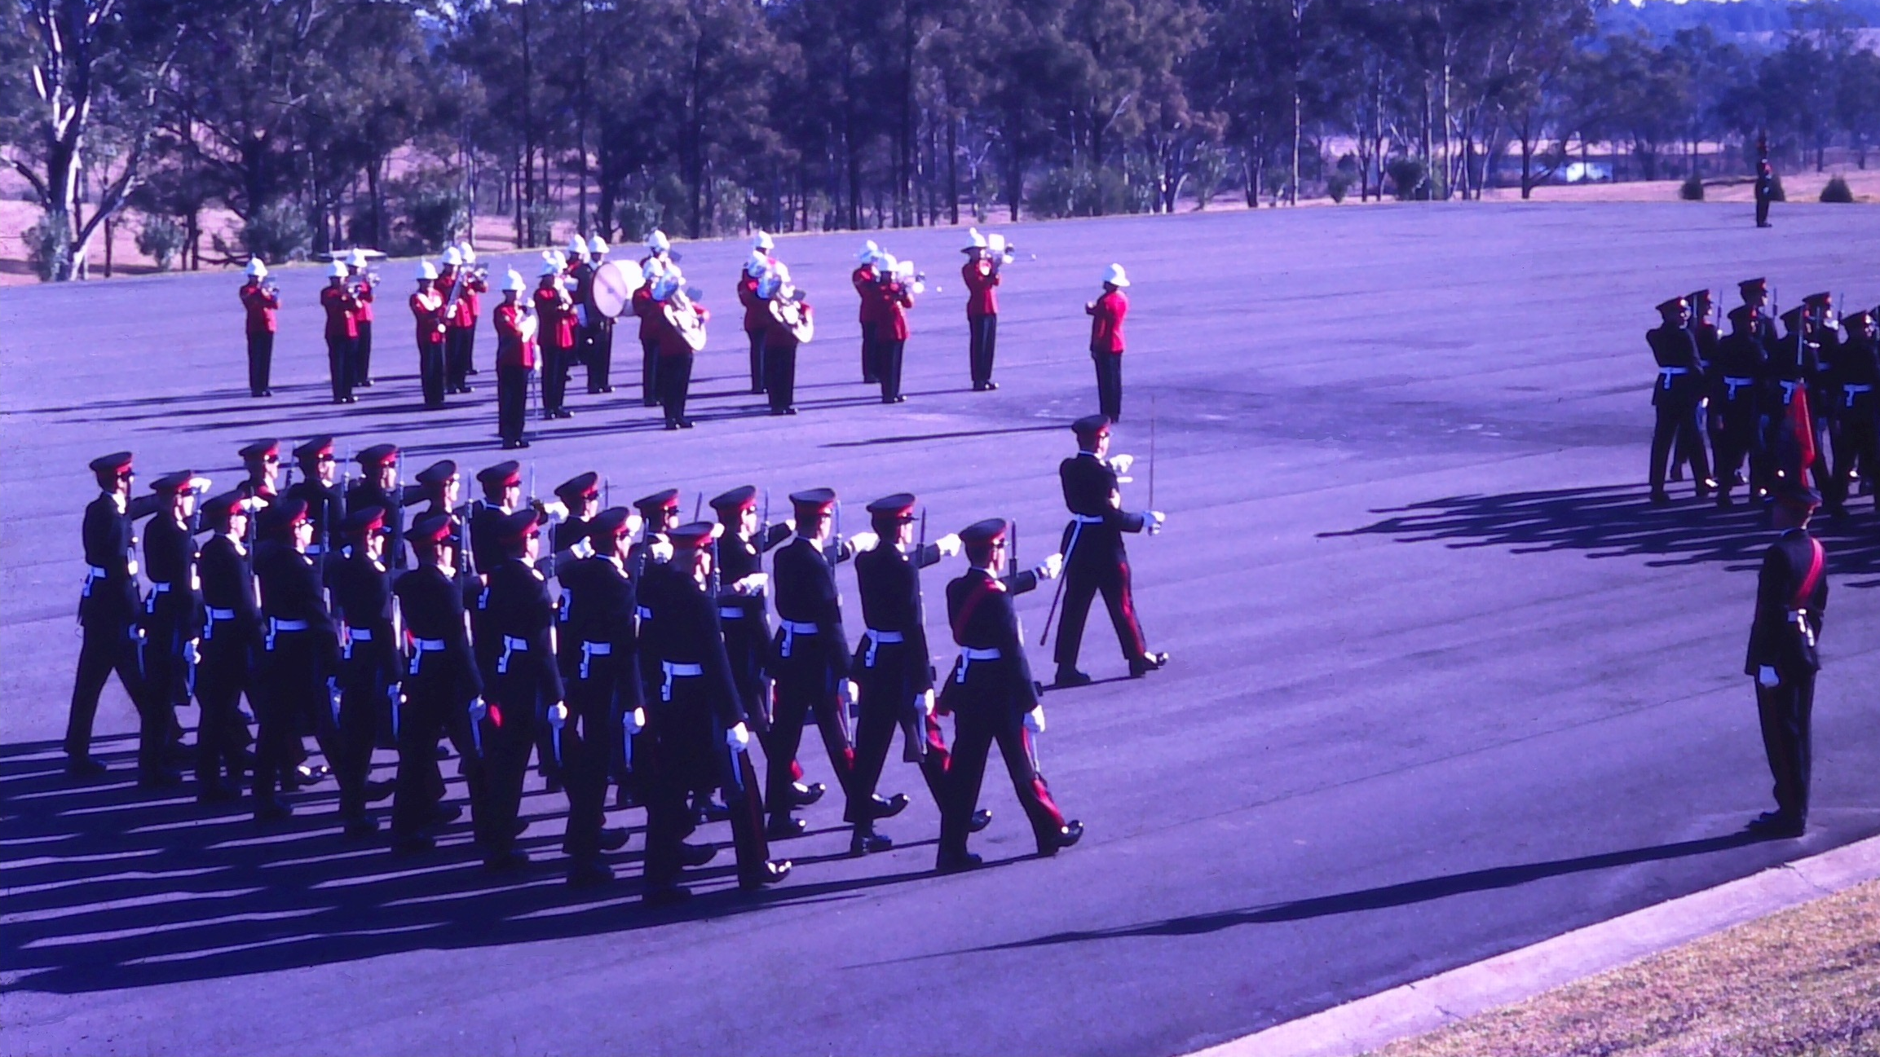

Slide 25
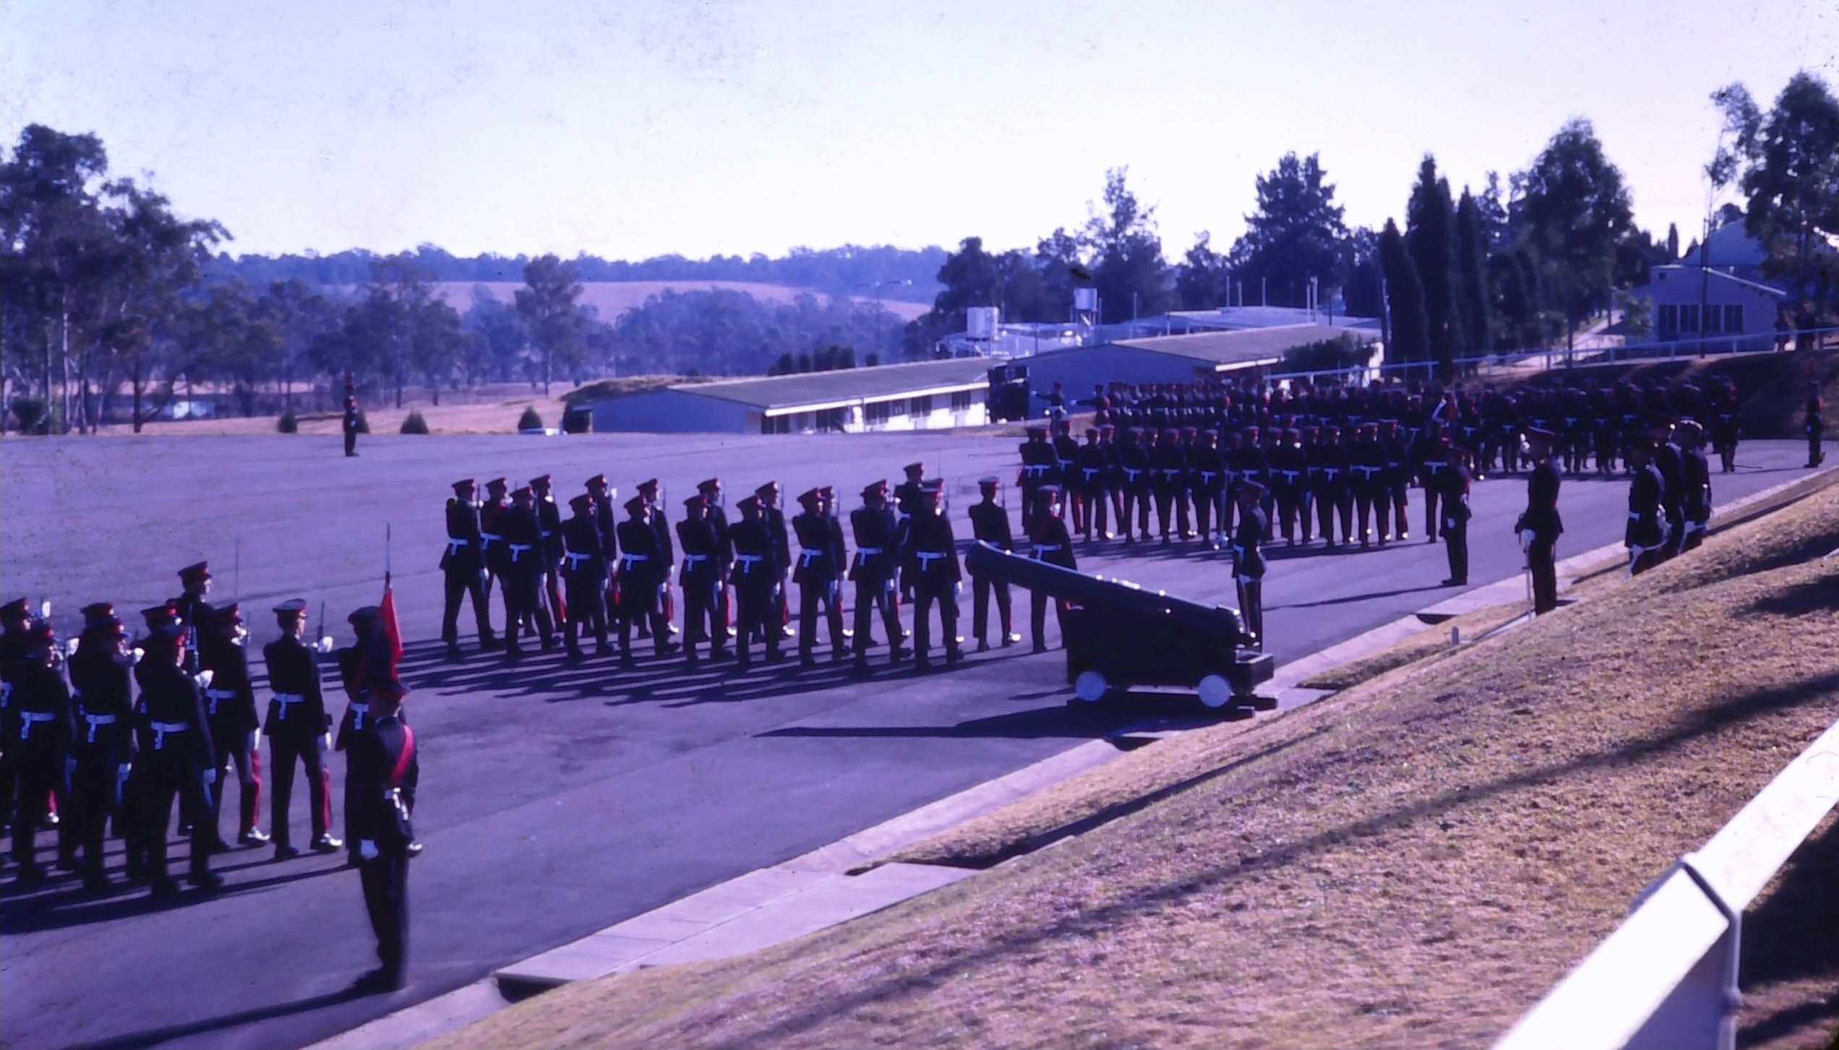

Slide 26
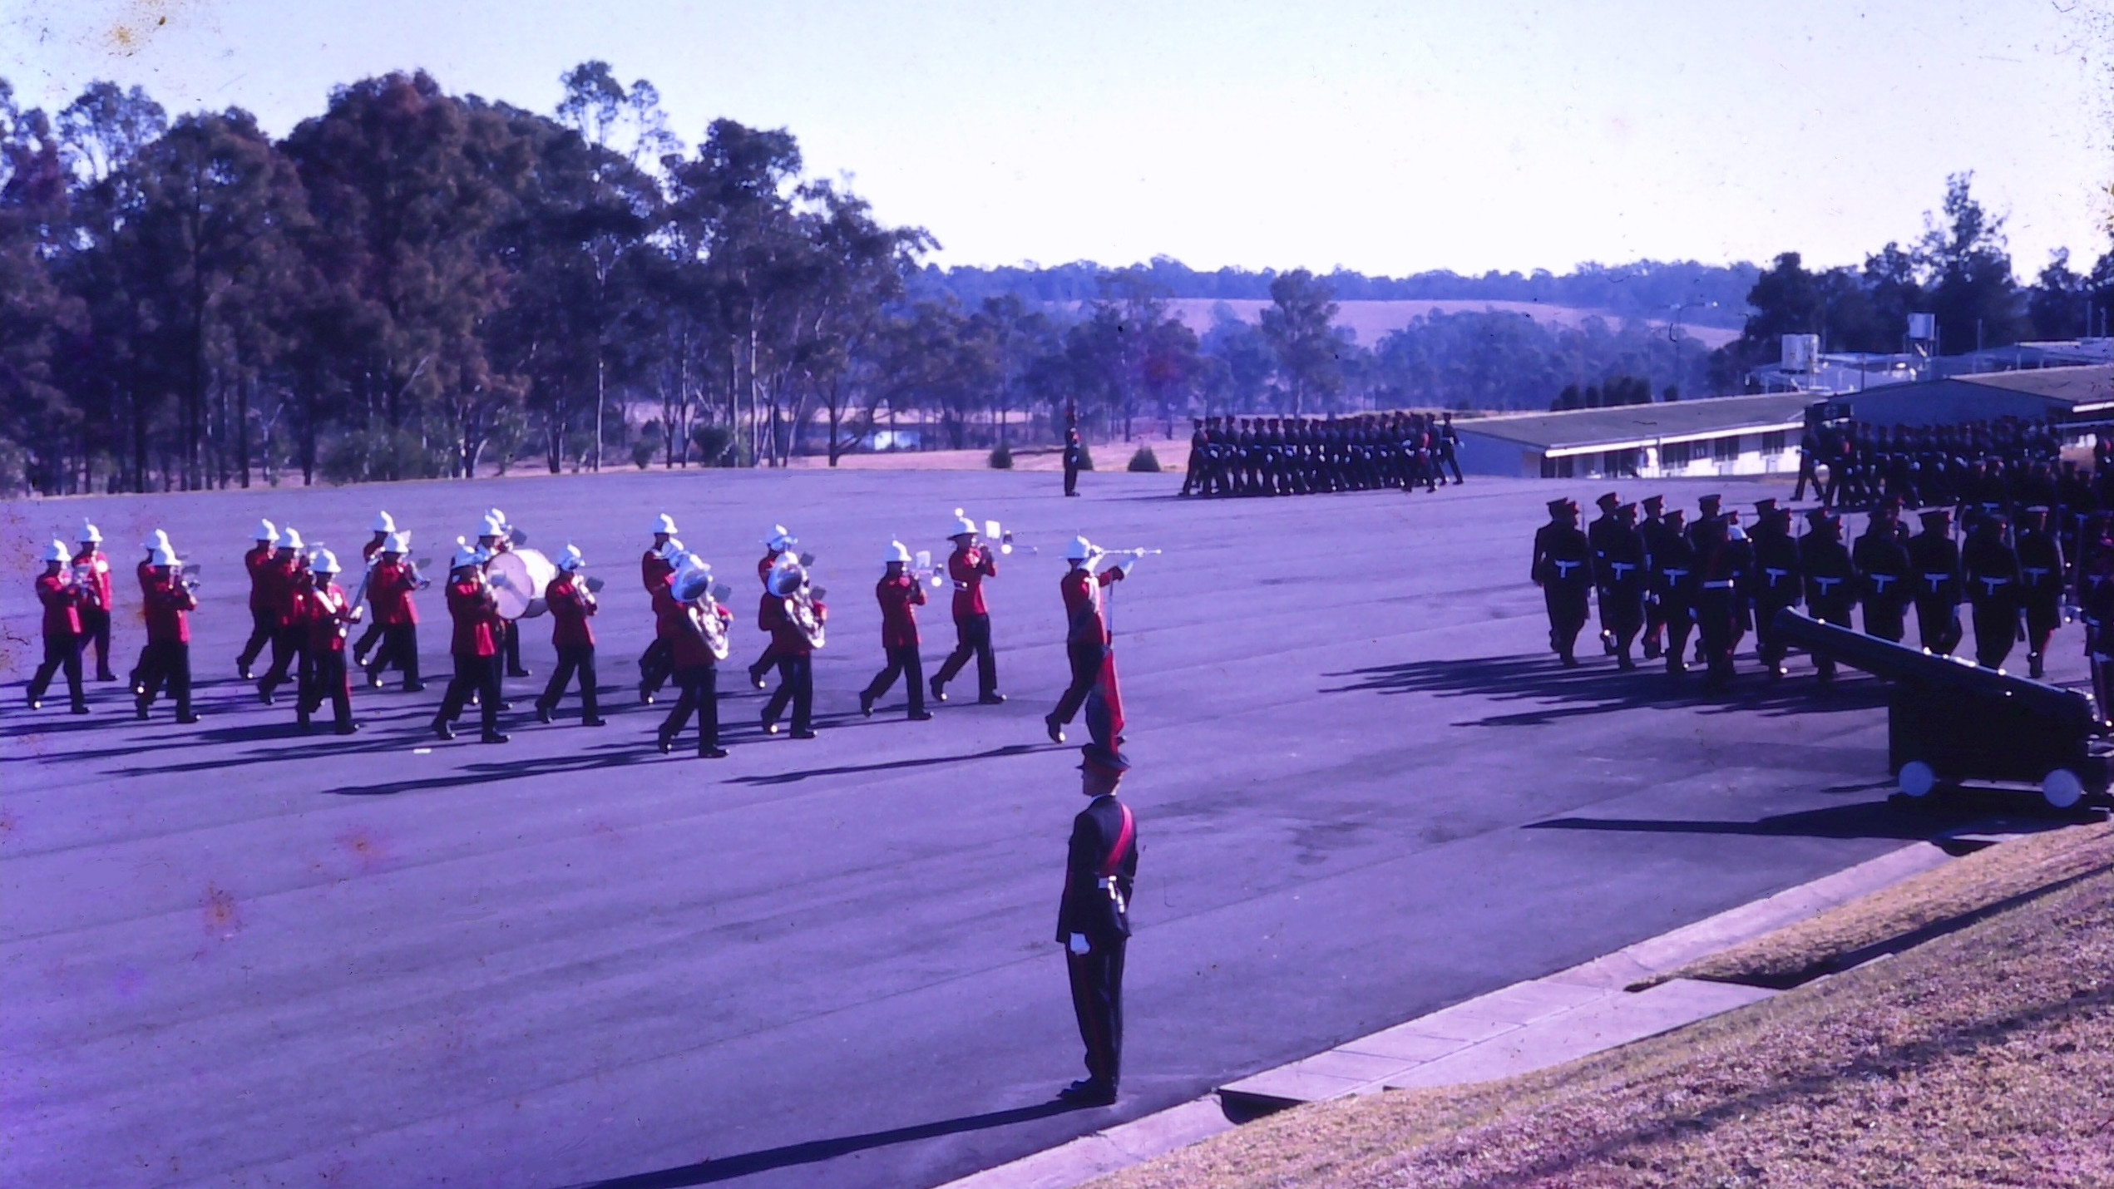

Slide 27
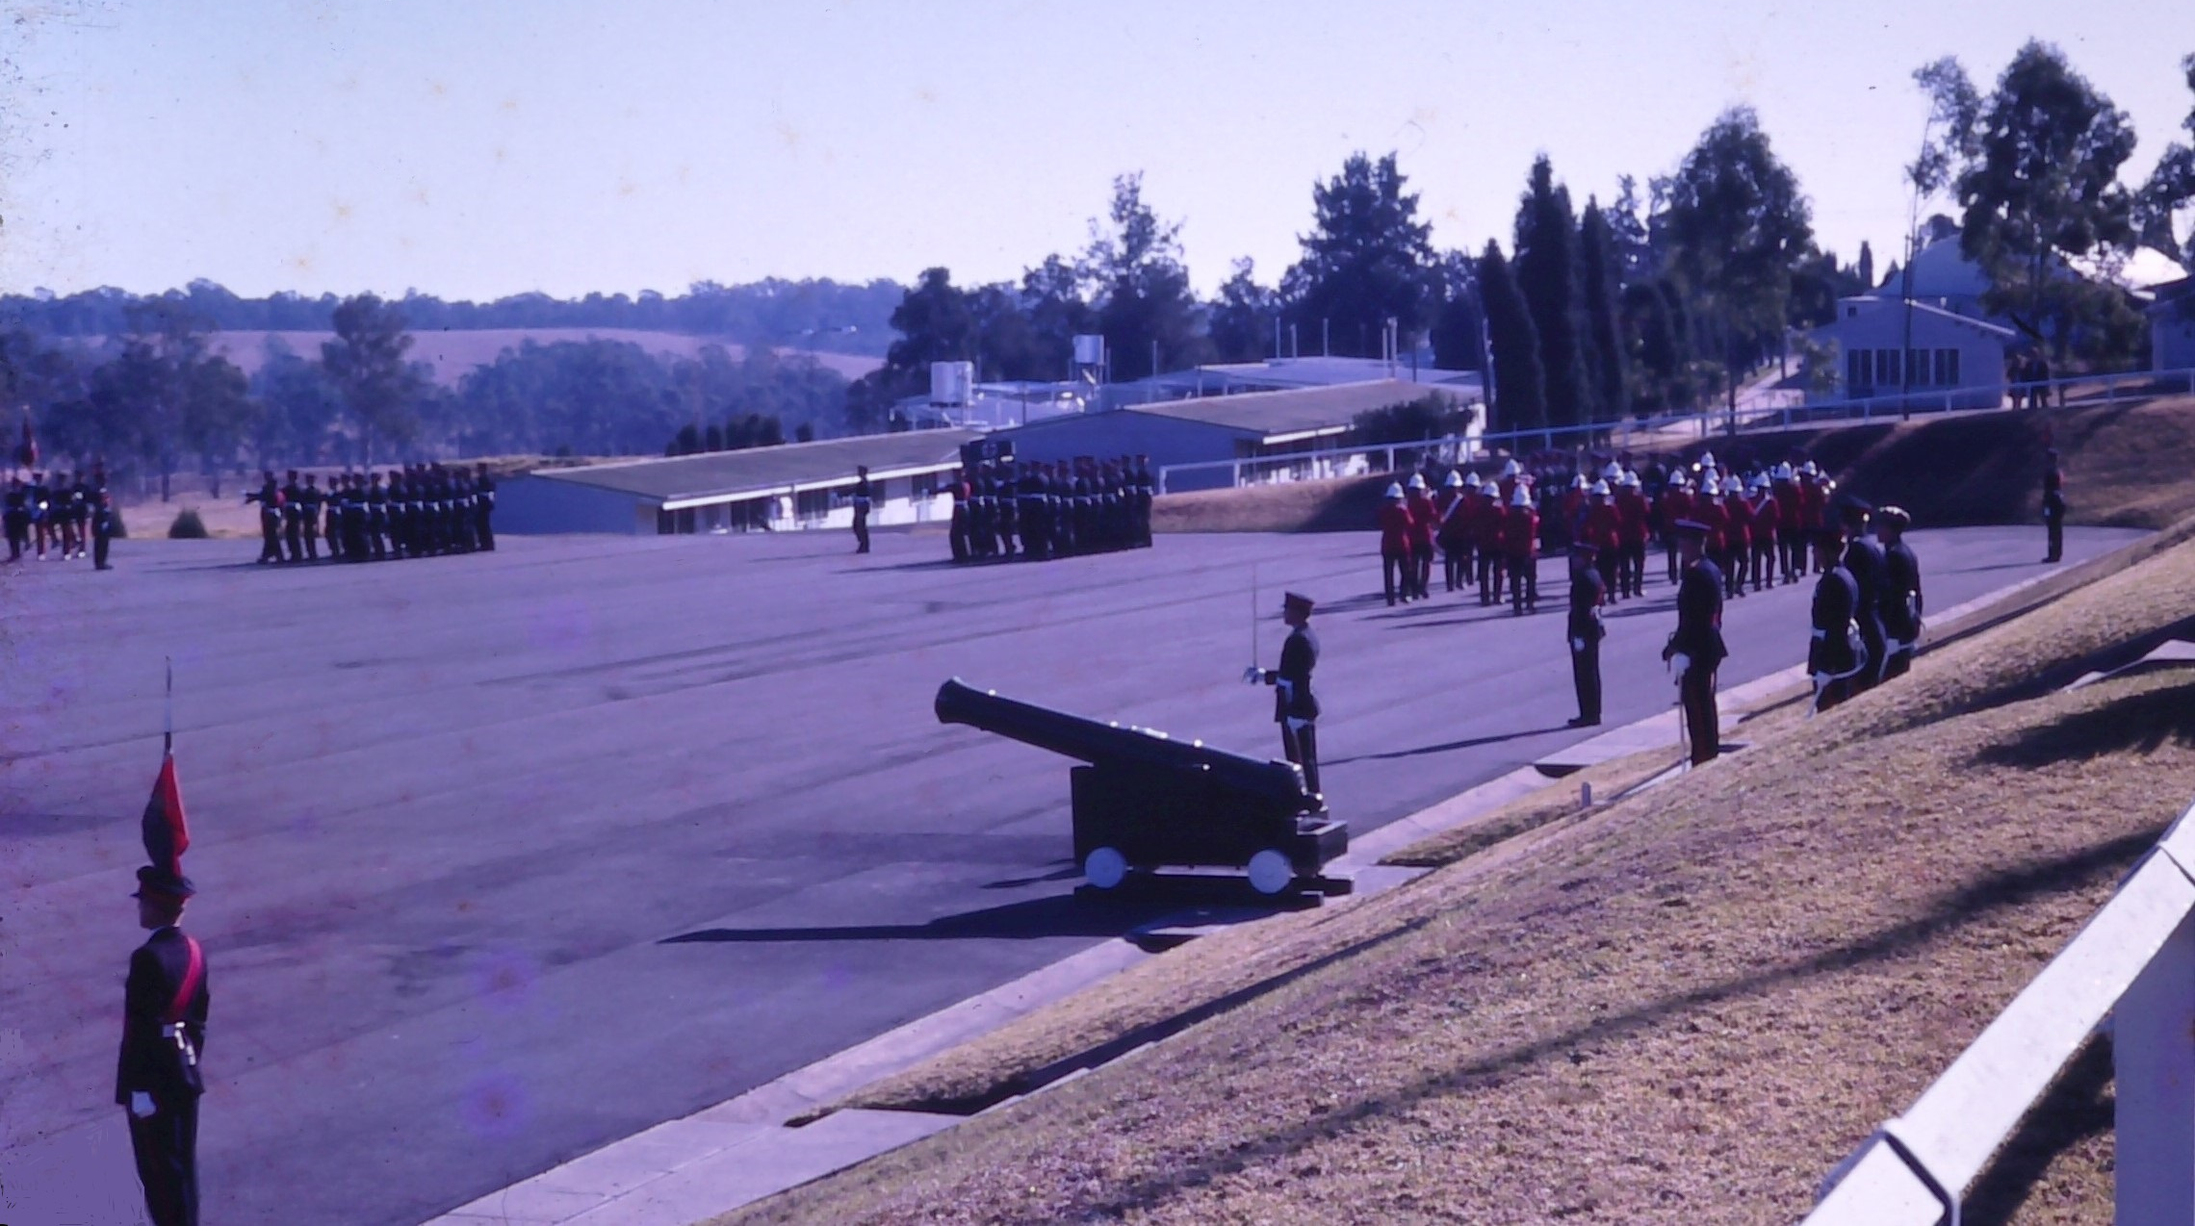

Slide 28
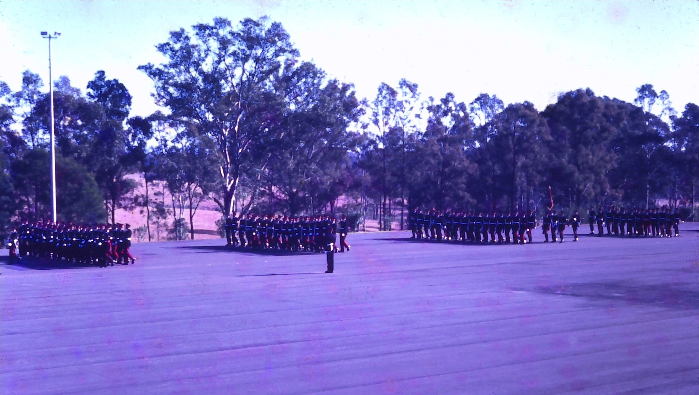

Slide 29
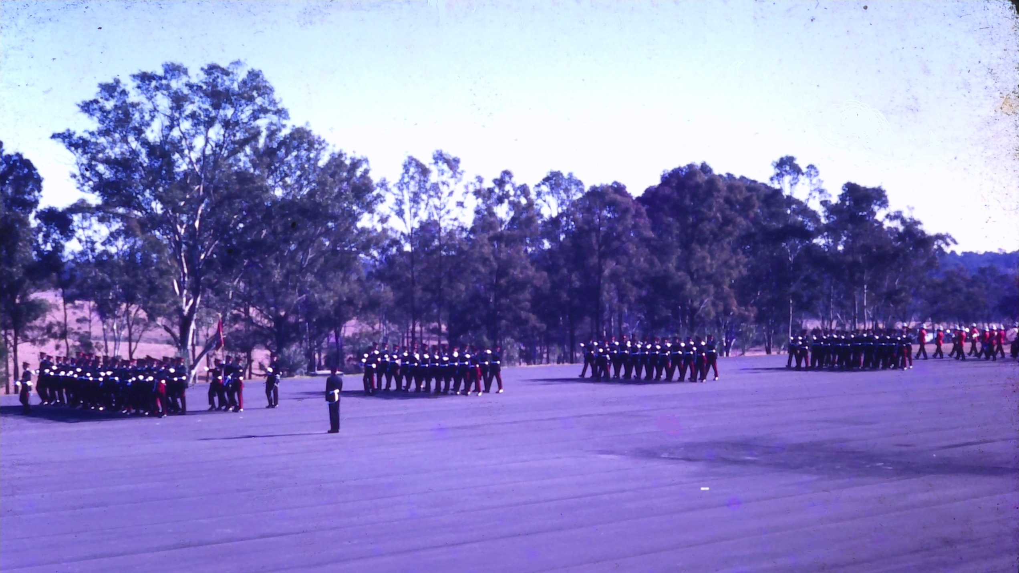

Slide 30
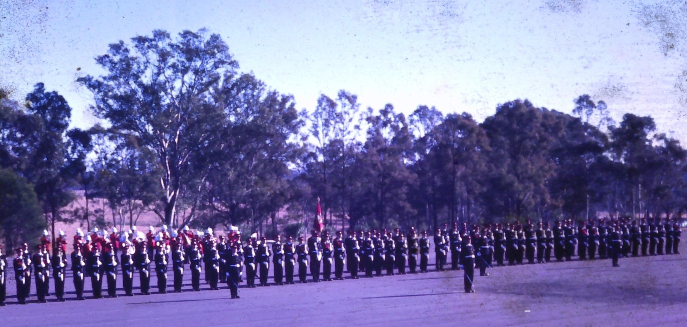
General Salute Following Advance in Review Order

Slide 31
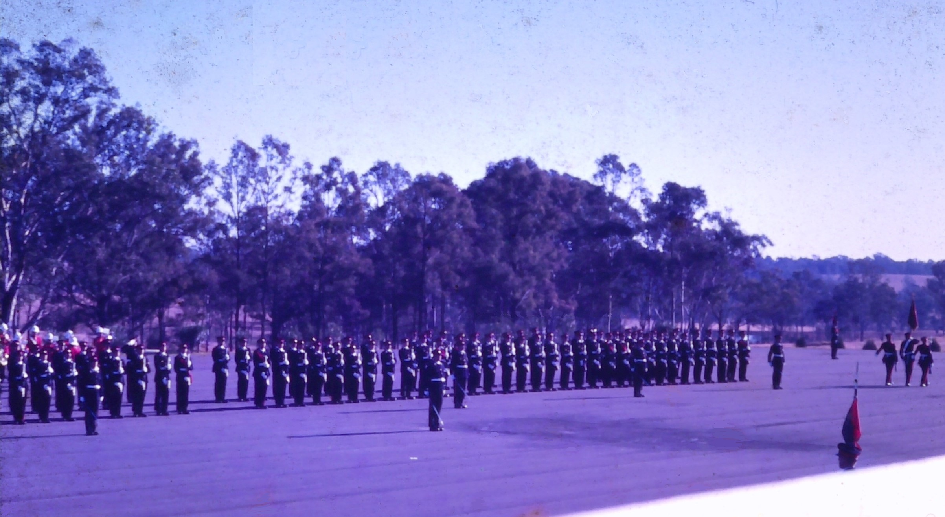
Governor-General’s Banner Party Marches Off

Slide 32
cbzcgvdr

